Slide 1
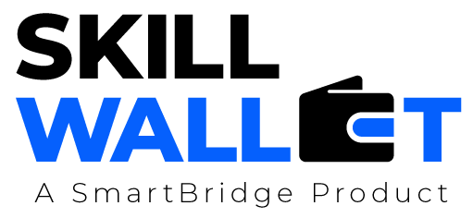
1.AI- Powered Lead Generation System
2.AI- Powered Student Admission System & Support Management System
3.AI-Powered Job Recruitment & Candidate Management System
4.AI- Powered Customer Support & Service Automation
5.AI- Powered Customer Support Ticketing System
Salesforce with AI
Use-Cases

Slide 2
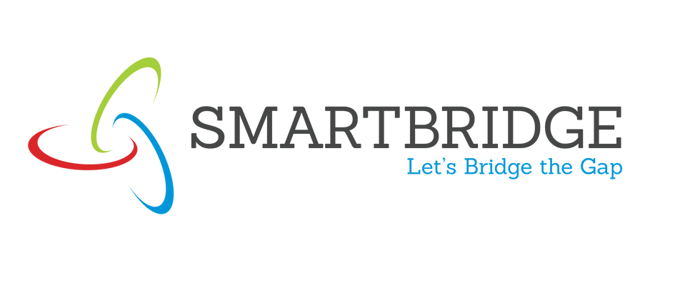
Project Problem Statement :
Modern sales teams receive a large volume of leads from websites, campaigns, and marketing channels, but they struggle to identify which leads are truly valuable. Manual lead scoring is slow, inconsistent, and dependent on human judgment, causing high-potential leads to be missed and low-quality leads to consume sales effort.
Organizations need an intelligent system that automatically analyzes lead information, predicts conversion potential, prioritizes leads, and suggests next actions so that sales representatives can focus on the most promising opportunities.
The challenge is to build an AI-powered Salesforce system that automates lead scoring, prioritization, alerts, and summaries while ensuring secure role-based access and scalable automation.
Use-Case - 1:
AI- Powered Lead Generation
SMARTBRIDGE

Slide 3
Social Impact:
Faster response to genuine customer inquiries
Fair and unbiased lead prioritization
Reduced employee workload and stress
Improved customer experience
Business Model /Impact:
Increased lead conversion rates
Better sales productivity
Reduced manual qualification effort
Higher revenue efficiency
Recommended Technology Stacks :
Salesforce CRM, Record-Triggered Flows, Agentforce AI, Prompt Builder, Lightning Experience, Reports & Dashboards
Use-Case - 1:
AI- Powered Lead Generation
SMARTBRIDGE

Slide 4
Project Problem Statement :
Educational institutions often struggle to manage student admissions efficiently due to fragmented data, manual prioritization, delayed approvals, and lack of intelligent insights. Admission teams rely heavily on spreadsheets, emails, and manual decision-making, which leads to inconsistent evaluation of applications, delayed responses to high-value candidates, and inefficient handling of discount approvals and risk cases.
The absence of centralized automation and AI-driven recommendations makes it difficult for counselors and managers to identify priority students, assess enrollment risks, and make timely approval decisions. As application volumes grow, institutions require a scalable, intelligent system that can streamline admissions workflows, automate approvals, and provide real-time insights to support proactive and data-driven decision-making.
The AI-Enabled Student Admissions & Support Management System addresses these challenges by centralizing student enrollment data, automating admission workflows, and embedding AI-powered prioritization and risk analysis directly into the Salesforce platform.
Use-Case - 2:
AI- Enabled Student Admission & Support Management System
SMARTBRIDGE

Slide 5
Social Impact:
Improves access to education by ensuring fair and faster admission decisions. Reduces human bias through AI-assisted evaluation. Enhances student experience with timely communication and support.
Business Model /Impact:
Accelerates admission processing and approvals. Increases enrollment conversion rates. Reduces operational workload for admission teams.
Recommended Technology Stacks :
Salesforce Platform Salesforce Flows & Approval Processes Agentforce AI Lightning Experience
Use-Case - 2:
AI- Powered Student Admission & Support Management System
SMARTBRIDGE

Slide 6
Use-Case - 3:
AI- Powered Job Recruitment & Candidate Management System
Project Problem Statement :
Modern organizations receive hundreds of job applications across multiple channels, making recruitment complex, slow, and inconsistent. Recruiters often rely on spreadsheets, emails, and manual screening processes, which leads to duplicate candidate records, delayed interview scheduling, subjective hiring decisions, and poor visibility into recruitment performance.
There is a strong need for an intelligent recruitment platform that centralizes candidate data, automates hiring workflows, and provides AI-driven evaluation to support recruiters and hiring managers. The system must prioritize high-value candidates, flag risky hiring decisions, enforce approval-based salary governance, and deliver real-time insights to improve recruitment efficiency.
An AI-powered Salesforce recruitment system addresses these challenges by automating candidate scoring, offer approvals, and recruiter notifications while enabling data-driven hiring decisions through Agentforce intelligence and workflow automation.
SMARTBRIDGE

Slide 7
Social Impact:
Fair and unbiased candidate evaluation
Faster hiring opportunities for applicants
Reduced recruiter workload
Improved candidate experience
Business Model /Impact:
Faster recruitment cycle
Higher hiring quality
Standardized approval governance
Increased recruiter productivity
Recommended Technology Stacks :
Salesforce CRM
Flows and Approval Process
Agentforce AI
Prompt Builder
Lightning Experience
Reports and Dashboards
Use-Case -3:
AI- Powered Job Recruitment & Candidate Management System
SMARTBRIDGE

Slide 8
Use-Case - 4:
AI- Powered Customer Support & Service Automation
Project Problem Statement :
An international electronics company struggles to manage a rapidly increasing volume of customer service requests related to orders, warranty claims, and product issues. Manual case handling leads to delayed responses, inconsistent service quality, and poor visibility into resolution performance. The organization needs an intelligent, automated support system that can streamline case routing, prioritize critical issues, and provide AI-assisted responses to improve customer experience and operational efficiency.
SMARTBRIDGE

Slide 9
Use-Case - 4:
AI- Powered Customer Support & Service Automation
Social Impact
Improves customer satisfaction by ensuring faster issue resolution and reliable service support. Enhances trust in digital customer service through AI-assisted interactions.
Business Model/Impact
Reduces manual workload and operational costs. Increases support efficiency and scalability.
Recommended Technology Stack
Salesforce Service Cloud Salesforce Flows & Automation Agentforce (AI Service Agent) Reports & Dashboards
SMARTBRIDGE

Slide 10
Use-Case - 5:
AI- Powered Customer Support Ticketing System
Project Problem Statement :
Customer support teams often struggle with manually managing large volumes of tickets, leading to delayed responses, inconsistent prioritization, and poor customer experience. Without automation and AI-driven insights, support agents spend excessive time analyzing issues instead of resolving them. Organizations need an intelligent ticketing system that can automatically classify cases, suggest responses, prioritize urgent issues, and help teams maintain SLA commitments while improving overall service efficiency.
SMARTBRIDGE

Slide 11
Use-Case - 5:
Ai- Powered Customer Support Ticketing System
Social Impact:
Faster issue resolution improves customer satisfaction
Reduces frustration caused by delayed support
Promotes reliable and accessible customer service
Builds trust between businesses and customers
Business Model/Impact:
Increased agent productivity
Reduced operational support costs
Improved SLA compliance
Better customer retention and loyalty
Recommended Technology Stack:
Salesforce CRM (Admin & Automation)
Record-Triggered Flows
Reports & Dashboards
Agentforce AI / Einstein Features
Custom Objects & Security Model
SMARTBRIDGE

